Slide 1

Salary Analysis Around the world
Name : Deepti Horakeri
Batch : B4 Online July
Date : 02/17/2025

Slide 2
Dataset overview:
Age Range: The age group of the individual.
Industry: The sector in which the individual works.
Job Title: The official position held by the individual.
Clarification of Job Title: Additional details about the job title.
Annual Salary: The individual’s annual salary or earnings.
Additional Monetary Compensation: Extra earnings beyond the base salary (e.g., bonuses, commissions).
Currency: The currency in which salary and compensation are reported.
Other Currency: A custom currency used when it does not match the standard options.

Slide 3
Income Clarification: Additional context regarding the income structure (e.g., commission-based).
Country: The country where the individual works.
State: The state or province of employment (if applicable).
City: The city where the individual works.
Years of Professional Experience Overall: The total number of years the individual has worked professionally.
Years of Professional Experience in Field: The number of years the individual has worked in their specific field.
Highest Level of Education Completed: The highest degree or educational level attained.
Gender: The gender identity of the individual.

Slide 4
Data Cleaning(Excel):
Remove duplicates to ensure unique records
Handle missing data by filling, replacing, or deleting blanks
Apply Find & Replace to fix errors and inconsistencies
Trim extra spaces using TRIM() function
Standardize date and number formats
Use Conditional Formatting to highlight errors
Convert text cases using UPPER(), LOWER(), and PROPER()

Slide 5
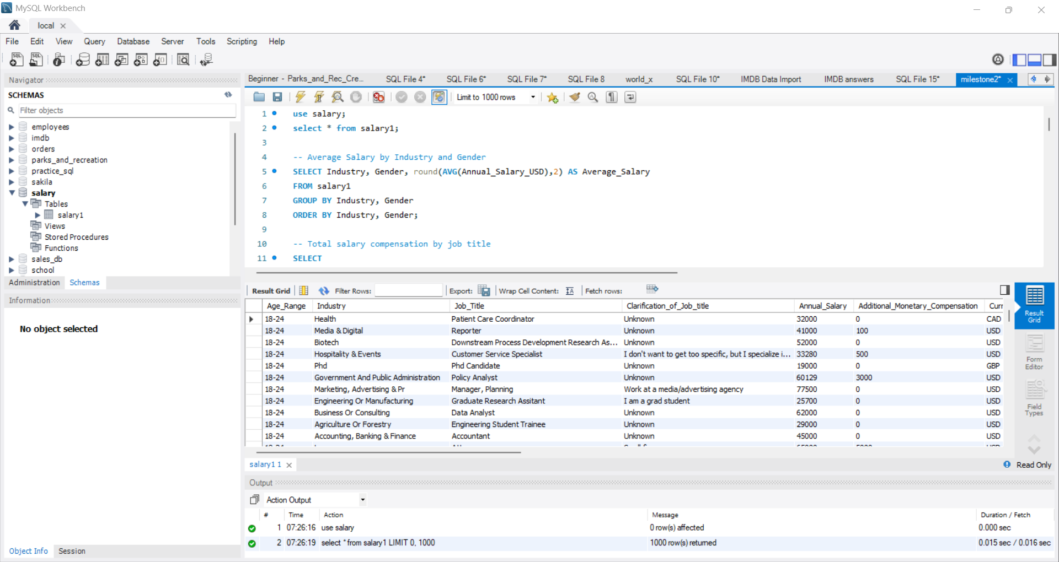
Importing the data into MYSQL:

Slide 6
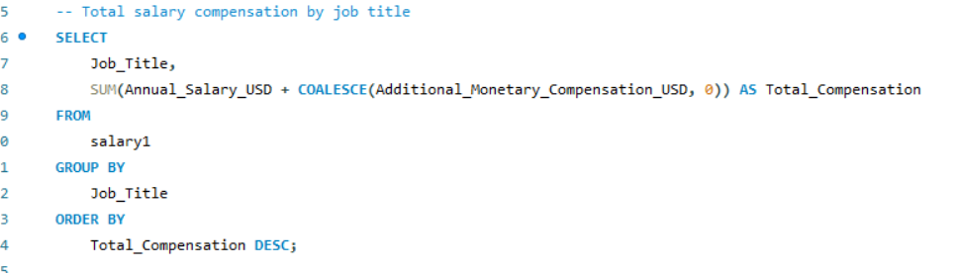
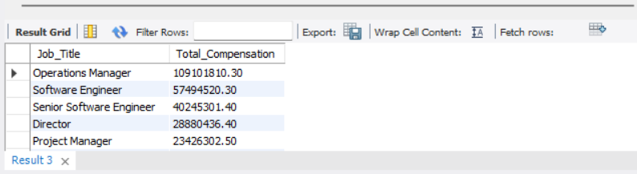
SQL Queries:
Total Salary Compensation by job:

Slide 7
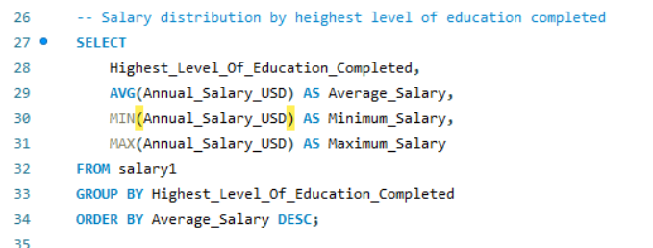
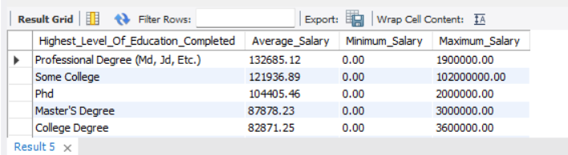
Salary Distribution by highest level of Education:

Slide 8
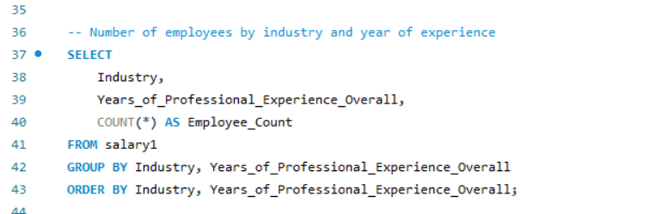
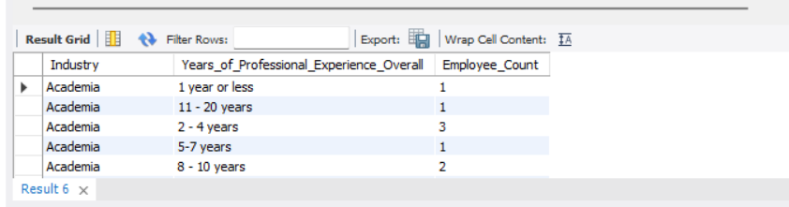
Number of employees by industry and year of experience:

Slide 9
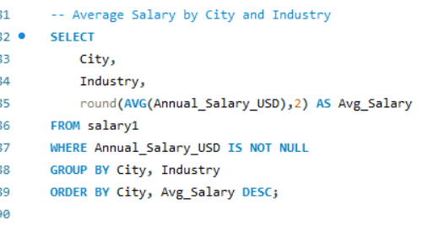
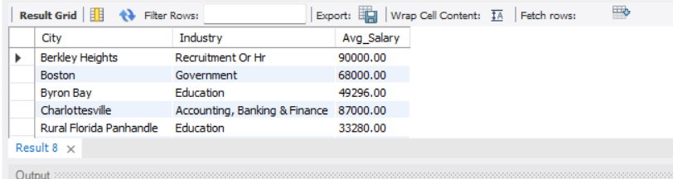
Average Salary By City and Industry:

Slide 10
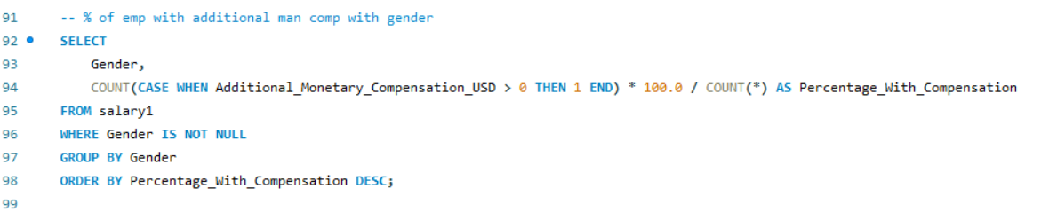
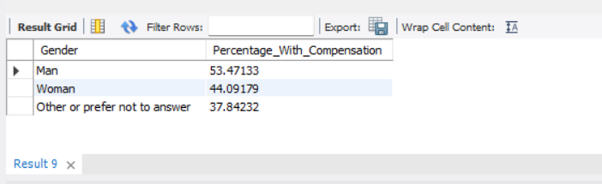
Percentage of employee with additional mandatory compensation with gender:

Slide 11
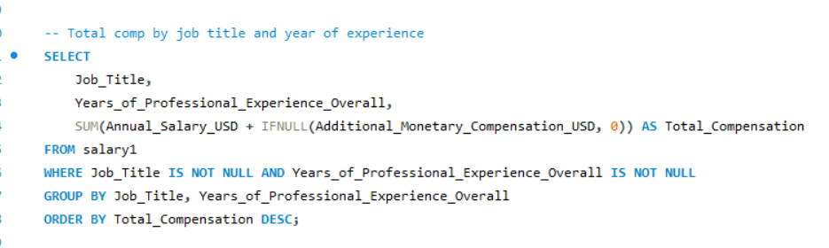
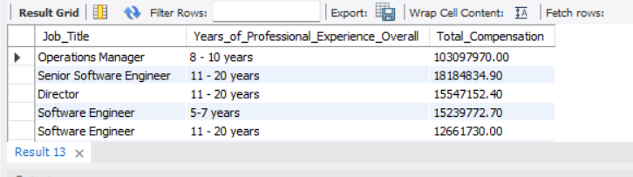
Total Compensation by job title and year of experience:

Slide 12
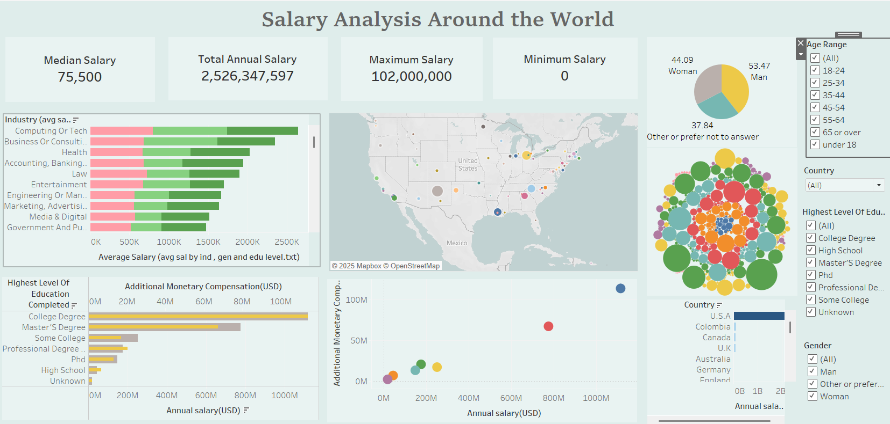

Slide 13
Key Insights:
In computing and tech for average salary
The City Albuqurque in USA is having maximum annual salary.
Highest level of annual salary is for Collage Degree .
As the annual salary increase additional mandatory compensation also increase highest for collage Degree with 1115612702.
Among countries USA is highest of annual salary.
Computing or tech background only having highest number of employees count for 11-20 years.

Slide 14

Thank You

